Slide 1
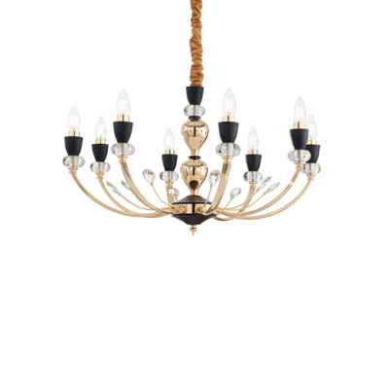
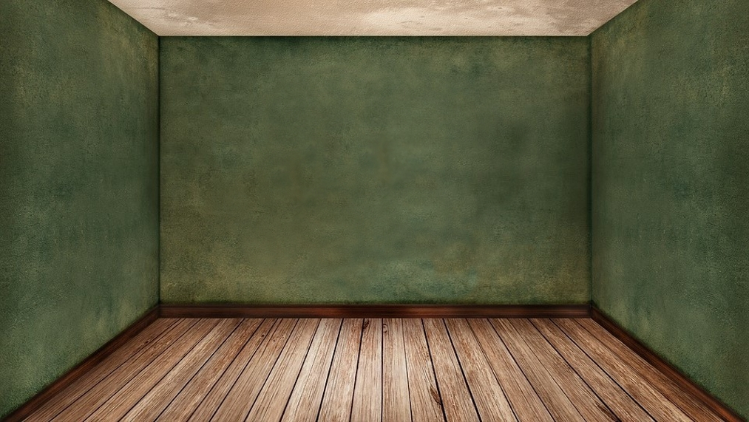
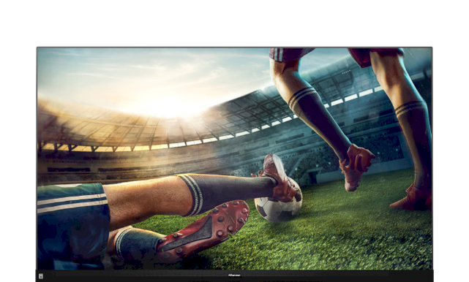
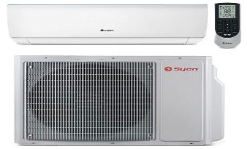

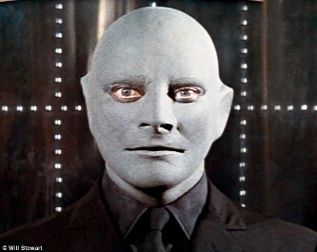







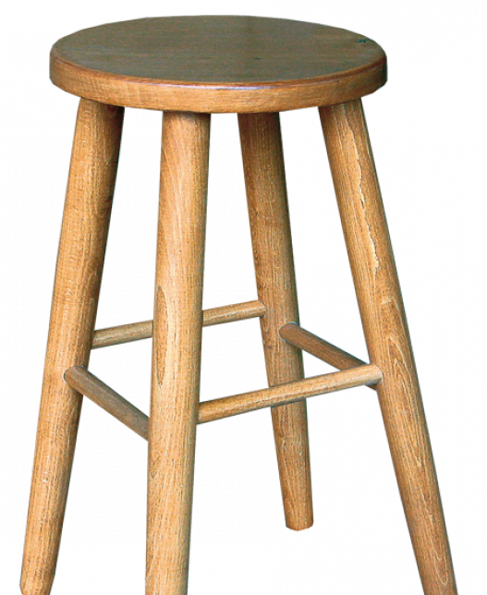



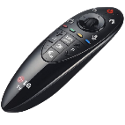
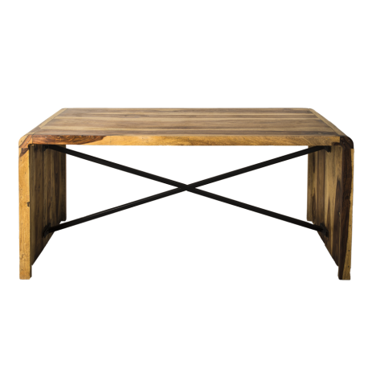


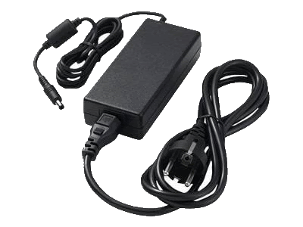
Good end
This word is a thing. This thing is quite little. It´s usually light. Most people need it very often. Some children don´t like to use it. You need water when you want to use it. This thing smells nice. It isn´t food. You have it in the bathroom. What is it?
Bad end
The end

Slide 2

There is nothing here.
Come back home!

Slide 3
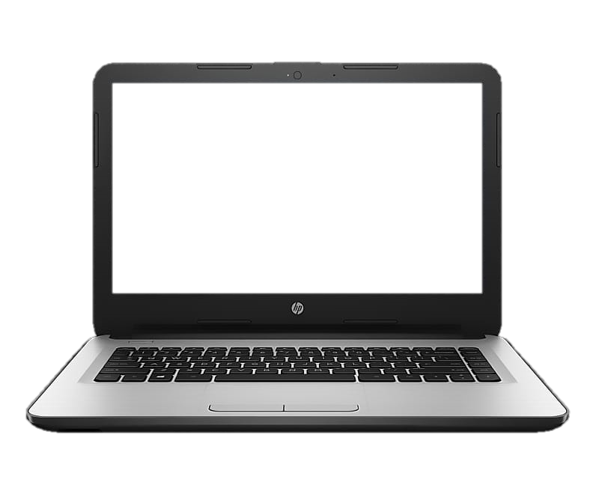




Slide 4

Have you got __ brother?
1
S a
R some
I any
W the

Slide 5

I have long neck. I have long legs. I am the tallest of all mammals. I eat leaves from bushes and trees. Who am I?
2
S Elephant
N Cow
T Giraffe
E Crocodile

Slide 6

Opposite: wet - __
3
O out
R dry
A slow
I big

Slide 7

Guess the word:
Generous, Gentle, Benevolent, Loving, Feeling, Good – natured, Melow, Mild …
4
S Happy
W Good
R Nice
A Kind

Slide 8

Other ways to say because.
5
W due to
K think
O hello
V may

Slide 9

Verb + Preposition (for)
6
J talk
B wish
F agree
K speak

Slide 10

I will take ___ my father‘s company.
7
E over
A down
I after
U off

Slide 11

Preposition of TIME isn‘t:
8
S in
R of
T at
W on

Slide 12

Part of the head is?
9
R Cheek
S Elbow
E Wrist
A Toe

Slide 13

____ represents a positive quantity. It used with plular nouns. It means some, a small amoun.
10
D Few
Y A few

Slide 14
There is nothing here.
Come back home!

Slide 15
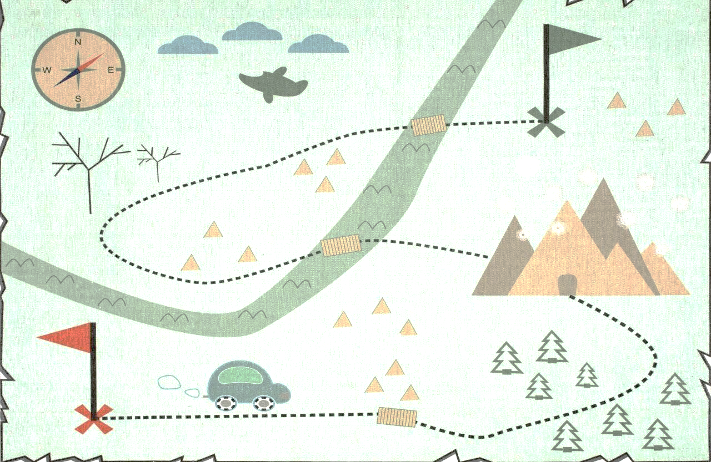




Slide 16

There is nothing here.
Come back home!
Come back

Slide 17
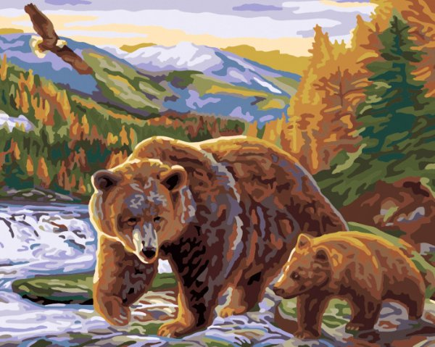
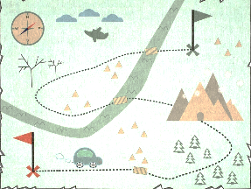

Choose 15 mammals
SNAKE
Come back
BIRD
GREYLAG
SQUIRREL
CAMEL
BEAVER
MOUSE
HIPPO
DIS -
RABBIT
CHAMELEON
STORK
CAT
EAGLE
BEAR
DOG
TIGER
FISH
TURTLE
LION
CAPR
ELEPHANT
SALMON
CROCODILE
SEAL
DONKEY
WOLF

Slide 18
There is nothing here.
Come back home!
Come back

Slide 19


Match a sentences with the tence.
I won‘t be a firefighter, it‘s very dangerous.
Come back
She‘s hardly ever late for school.
Look at the sentences.
Click on the tence and check your answer.
We are watching a great film.
Look at the sentences.
Click on the tence and check your answer.
We‘re going to meet the singer.
- co -
Why did she buy this book?
Listen to your teacher.
You haven‘t seen this film.
I was cycling home in the morning.
PRESENT PERFECT
ROZKAZOVACÍ VĚTA
PRESENT SIMPLE
FUTURE
FUTURE
PRESENT COUNTIONS
PAST COUNTIONS
PAST SIMPLE

Slide 20
There is nothing here.
Come back home!
Come back

Slide 21
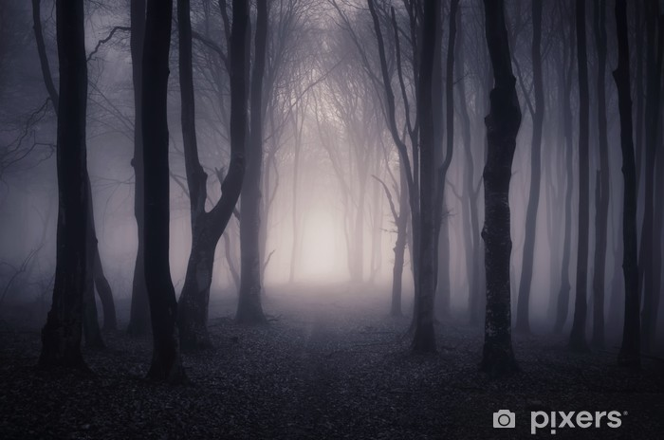


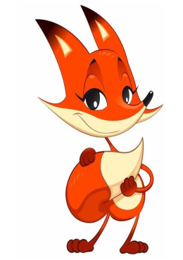

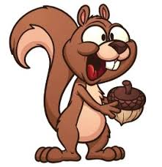



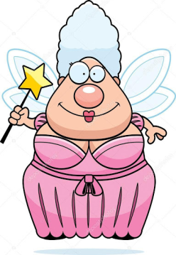
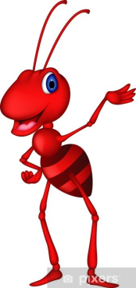
Done!
Done!
Done!
Done!
Done!
leaves
-ver
Done!
Done!
Done!
Done!
Done!
ant
squirrel
fay
Done!
Done!
Done!
Done!
Done!
fox
cottage
owl

Slide 22
There is nothing here.
Come back home!
Come back

Slide 23
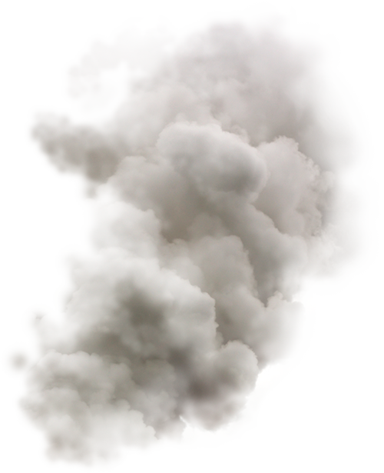

THE END
(you are dead)
This word is a thing. This thing is quite little. It´s usually light. Most people need it very often. Some children don´t like to use it. You need water when you want to use it. This thing smells nice. It isn´t food. You have it in the bathroom. What is it?

Slide 24
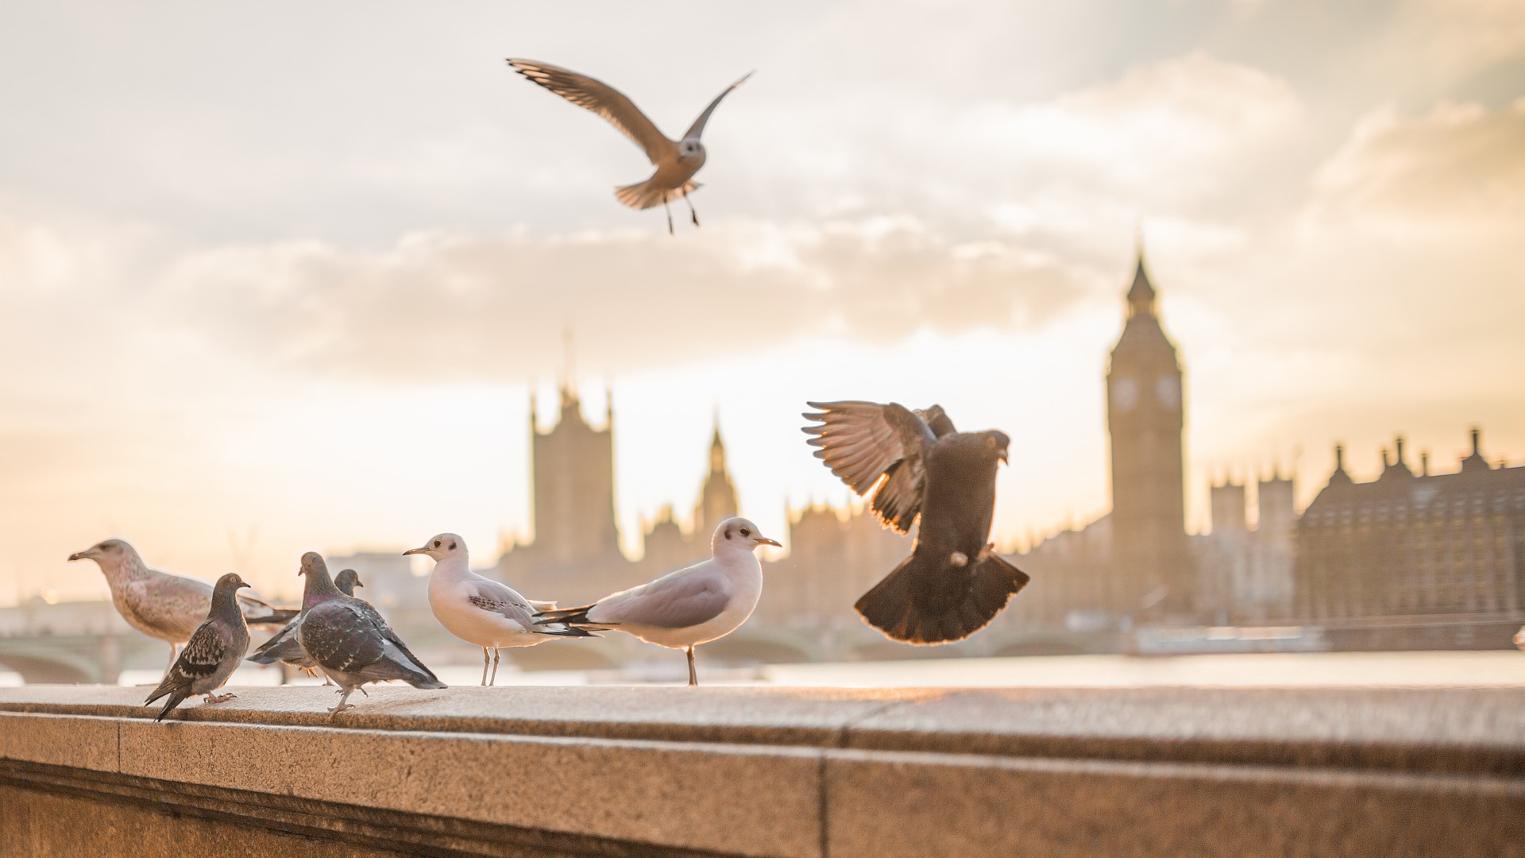
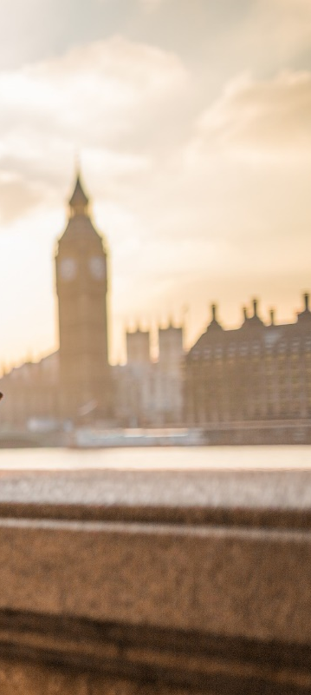

You are free!!!
This word is a thing. This thing is quite little. It´s usually light. Most people need it very often. Some children don´t like to use it. You need water when you want to use it. This thing smells nice. It isn´t food. You have it in the bathroom. What is it?

