Slide 1
Important and interesting vocabulary about your health
Kristýna Veselá

Slide 2


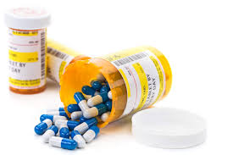

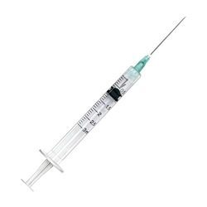

Let´s test your knowlodge
Notes:
Try to tell me as most word regarding health as much you can. You can see some pictures which can help you and remind you. For example the lady in white coat is who? - she can be a doctor or a nurse…
Scar Meds (medication, drugs!) disabled (invalid) syringe doctor (nurse) waiting room
I think you probably wonder why are there pictures of some famous disney characters? perhaps some of you already know? could someone tell me?
First one is from movie called Lion king - his name is Scar after his scar that he has over his eye the second one is Nemo from so called movie, who know why i put him here? Do you know any other disney characters who have some kind of injury or disability?

Slide 3
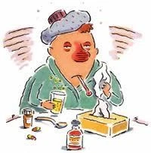


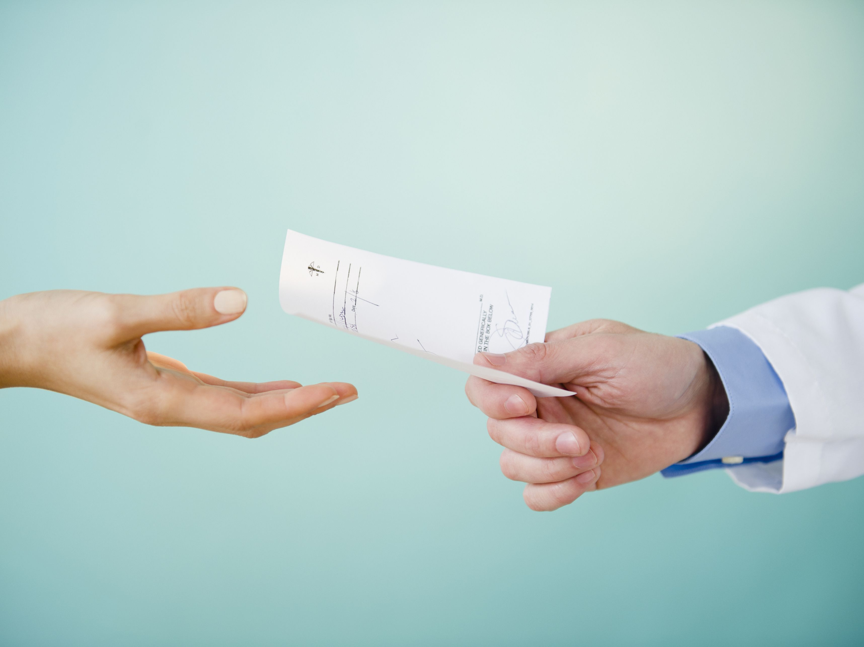

Typical situation
Notes:
Now lets create a situation, you are not feeling good (ill) and you go see the doctor. Use pictures for help.
1. picture - you are not feeling good, feeling ill, you have fever maybe you are coughing your stomach is upset You were trying some homeopathic methods but nothing worked. First you though maybe you just catched cold but now you think it may be a flu.
2. You decide you need to see medical care, you go to nearest hospital or to your doctor, you sit and wait in the waiting room till they call you. Usually you need to hand them your insurance card.
3. They call you in. Doctor is start with your examination. He/she checks your fever with thermometer, maybe checks your eyes with flashlight and look into your mouth if your glands are swollen. → 4. he/she prescribe you some medicine.--> you take you prescription and go to pharmacy or a drug store. There you hand over your prescription and lady behind the counter give you your medication.
Of course it´s not always like that. What else can happened to you? or when other time do you go see the doctor? For example if you are riding a bike and you fall how can you injure yourself?

Slide 4
Vocabulary (you should know)
vyrážka – rash
třást se – shake
modřina – bruise
popálenina – burn
podrážděný žaludek – stomach upset
cítit se vyčerpaně – feel run down
bolest – ache
bolest v krku – sore throat
bolest hlavy – headache
bolest zad – backache
bolest břicha – stomach ache
bolest zubu – toothache
ztráta vědomí – loss of consciousness
zimnice – chill
krvácení – bleed
stehy – stitches
jizva – scar
break – zlomit
chřipka – flu
nachlazení – cold
cukrovka – diabetes
rakovina – cancer
doktor – doctor
zdravotní sestra - nurse
čekárna – waiting room
prohlídka – examination (preventive/emergency)
pacient – patient
nemocnice – hospital
lékařská péče – medical care
recept – prescription
injekční stříkačka – syringe
teploměr – thermometer
běžná nemoc – common illness
teplota – temperature
(vysoká) horečka – (high) fever
kašel – cough
náplast – plaster
tříska – splinter
spálený sluncem – sunburnt
omdlít – faint
zvracení – vomiting
vyrážka – rash
třást se – shake
pojištění - insurance
prescribe - předepsat
Notes:
Don´t get scared it may seem like there is so much words but most of them you already know or we talked about them now. If you want you can write some of them down… And don´t worry if you forget some of them you can alway in any situation describe them. Also you may notice that some words are similar in CZ to EN - dezinfekce….

Slide 5
Typical phrases
What's the matter? →
I'm not feeling well. →
I've cut myself. →
I've got a headache. →
I've got a pain in my …. →
My … are hurting →
My back hurts. →
Have you got any …? →
Are you feeling any better? →
Get well soon! →
I think you should go and see a doctor. →
I'm going to be sick. →
Notes:
There are some typical phrases, please try to translate them. Have you heard any of it?

Slide 6
Zdroje:
https://www.anglictinazdarma.cz/slovni-zasoba-zdravi-a-nemoci/
https://tr-ex.me/p%C5%99eklad/%C4%8Desk%C3%BD-anglick%C3%BD/p%C5%99edepsat?search=p%C5%99edepsat
https://cs.speaklanguages.com/angli%C4%8Dtina/fr%C3%A1ze/zdrav%C3%AD

