Slide 1

THE EUROPEAN UNION
THE WORK OF AMBASSADOR
DIPLOMATIC PROTOCOL
HOW IT´S WORKING ?

Slide 2


WHAT IS EU?
INTERNATIONAL ORGANIZATION.
PARTNERSHIP BETWEEN 27 COUNTRIES.
CURRENCY- EURO €
EUROZONE
SCHENGEN
IT HAS DELIVERED 1,5 CENTURY OF
PEACE, STABILITY AND PROSPERITY.
MOTTO: UNITED IN DIVERSITY
MISSION?

Slide 3
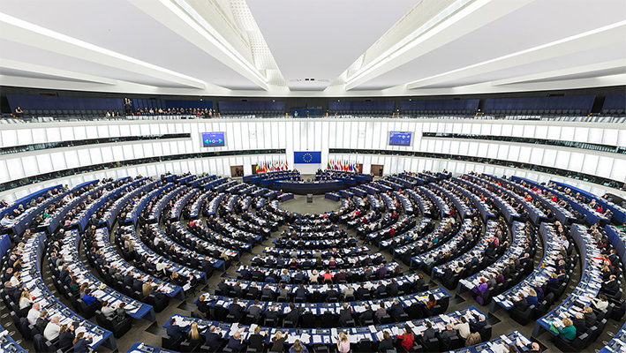
THE EUROPEAN PARLAMENT
751 SEATS
ELECTED EVERY 5 YEARS
CZECHIA 21 SEATS
APPROVES BUDGET AND LAWS
MEETS IN STRASBOURG

Slide 4
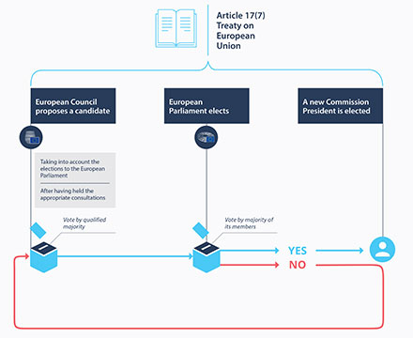
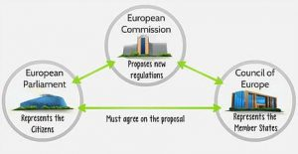

Slide 5
I WANT TO BECOME AN AMBASSADOR...
WHO IS AMBASSADOR?
WHAT AMBASSADOR DOES?
HOW HE/SHE HAVE TO ACT?
WHAT ARE THE - AND + OF THIS JOB?
WHAT ABOUT KNOWLEDGE YOU NEED FOR THIS JOB?
WHAT ABOUT PAYMENT?

Slide 6
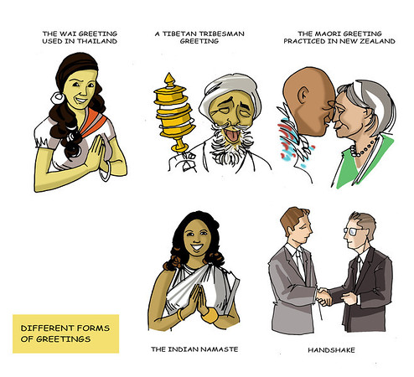
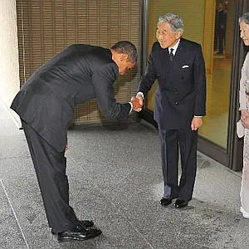
DIPLOMATIC PROTOCOL
A PROTOCOL IS AN RULE WHICH DESCRIBES HOW AN ACTIVITY SHOULD BE PERFORMED, ESPECIALLY IN THE FIELD OF DIPLOMACY
ETIQUETTE….

Slide 7
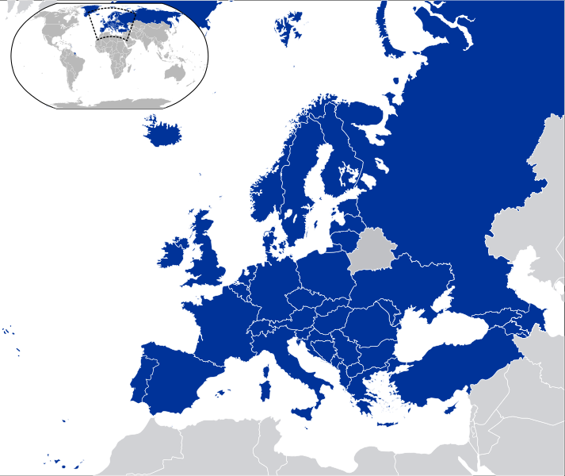

LET´S EXPLORE EUROPE!
GAME- LET´S EXPLORE EUROPE

